Slide 1
Redmine Guideline
Delivery Competency, GADC

Slide 2
Content
Introduction
Settings
Usage
Application
Reference

Slide 3
Introduction
Purpose
This guideline for Redmine tool for agile test management.
Scope
This guideline will provide the basic operation for agile test management.
(Settings and Usage)
Target Reader
Who want to know or use Redmine tool.
Assumption
The audience of this guideline has basic knowledge with agile methodology.

Slide 4
Settings
Login
Project Creation
Administration
Role and Permissions
User Creation
Issue statuses
Trackers
Custom fields
Plug-in Settings

Slide 5
Login
Log in URL:
http://www.gadc-ci-s1.sony.co.jp:3000
Contact to the following mail list for adding project on Redmine
GADC-ITSM-QA-Planning
GADC-ITSM-QA-Planning@ap.sony.com

Slide 6
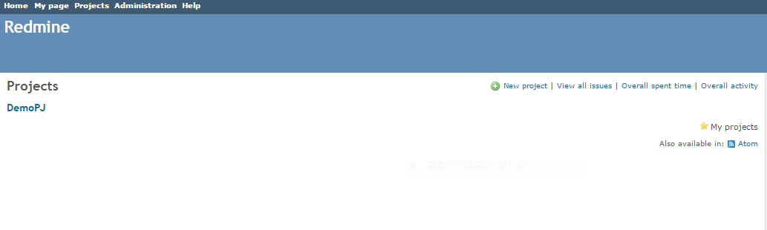
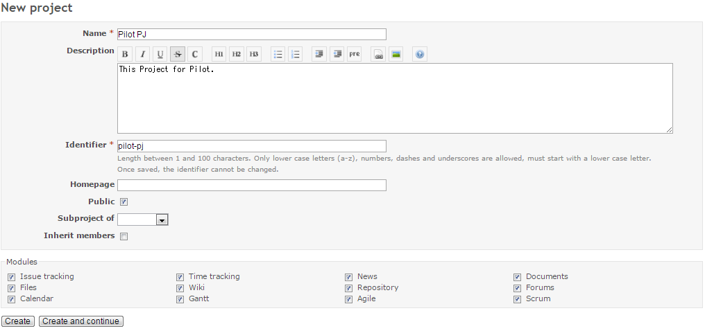
Project Creation
Create a new project for your team.
Input your project name and can add some comment for your project.
Check the Agile and Scrum box in modules part.

Slide 7
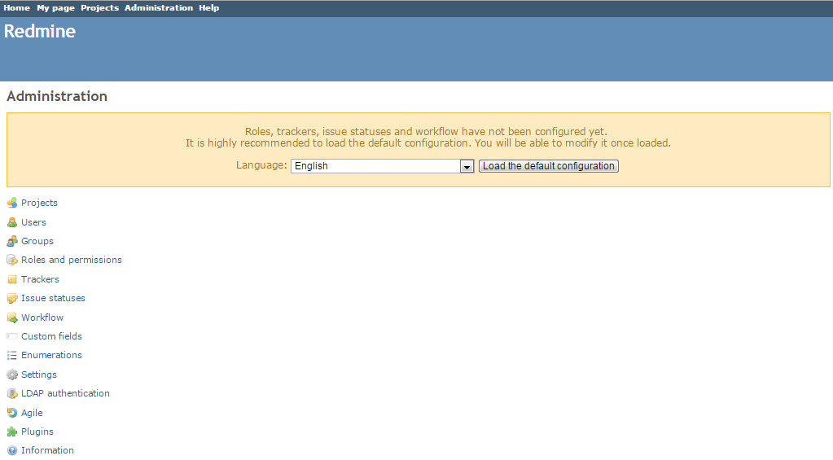
Administration
Click Administration for overall project setting.
Projects creation, Users creation, Roles and permissions, Trackers, issue statuses, Custom fields,
Settings etc.

Slide 8
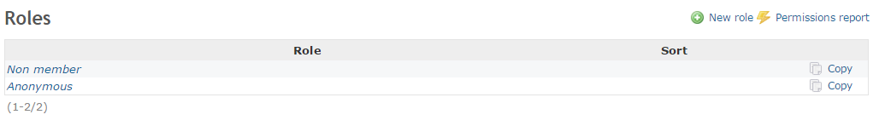
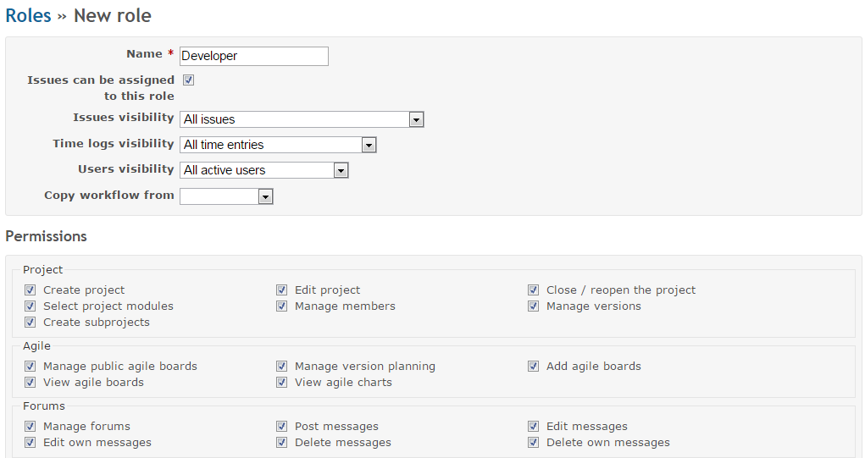
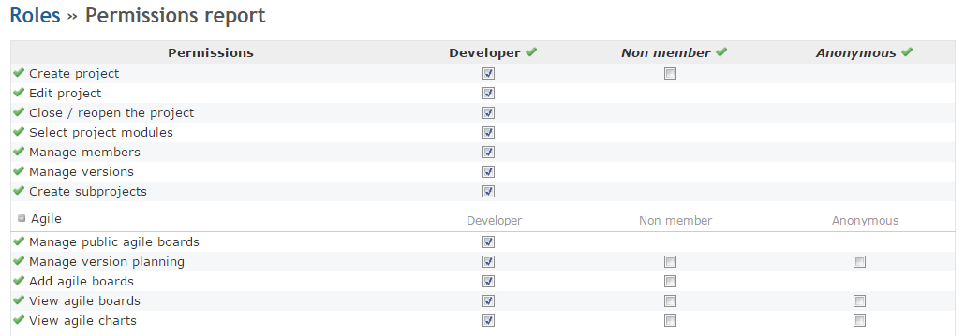
Role and Permissions
Create the roles for your project like developer and manager.
You can click Permissions report to confirm and update the permissions for each role.

Slide 9
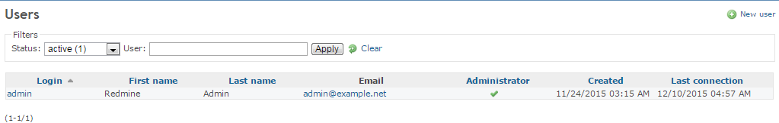
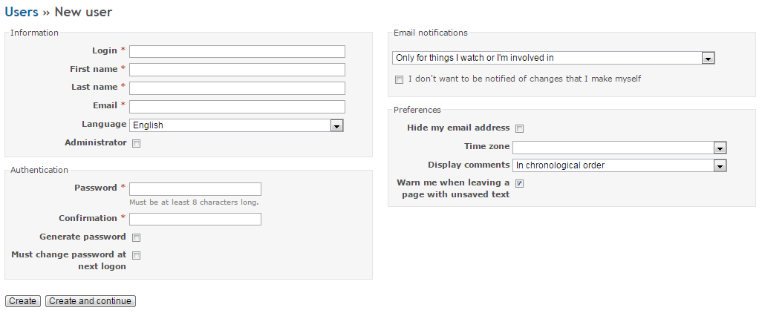
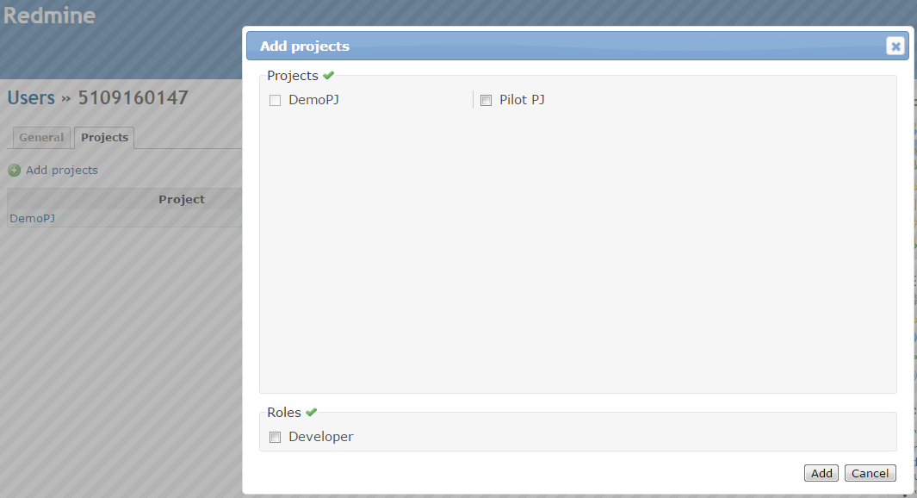
User Creation
1.Create new user for your team member. One person can be checked as an Administrator.
Input the detailed information and initial password for the members and check the must change password at next logon box for password changing.
2.Add users to projects and check the roles.3.Share the ID and password to members.

Slide 10
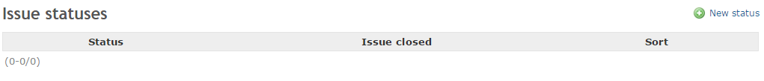
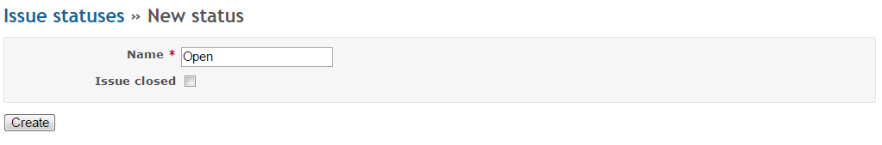
Issues statues
Create the statuses for your project.
You can also update/delete it.

Slide 11
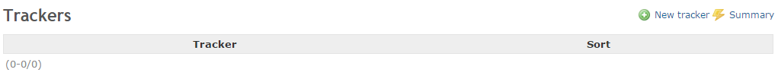
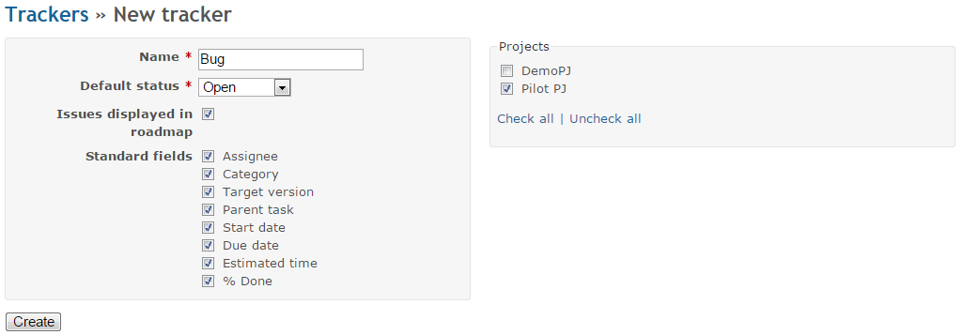
Trackers1/2
Create the trackers for your project.
(Bug/Task/Risk/Issue/Todo/Test Case/User Story etc.)
Select the Standard fields and custom fields what you need.

Slide 12
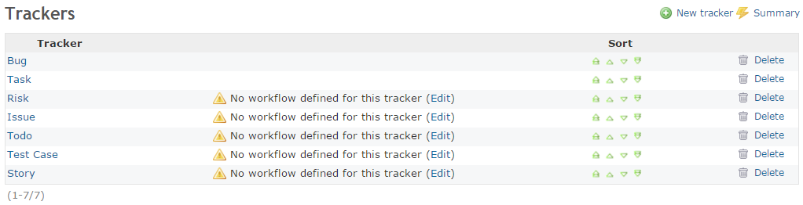
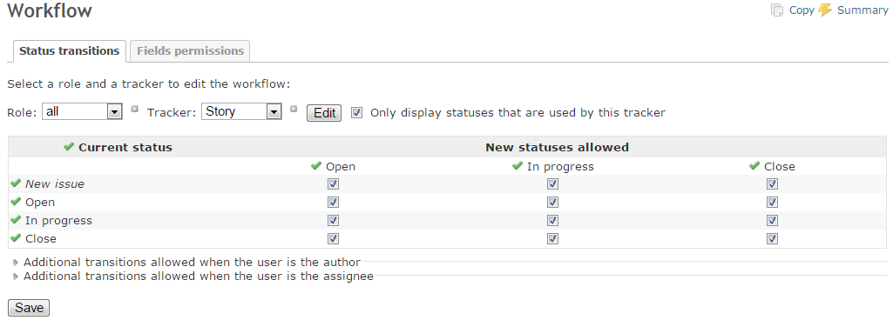
Trackers2/2
Set work flow for each tracker.
Click edit and set the work flow for it.

Slide 13
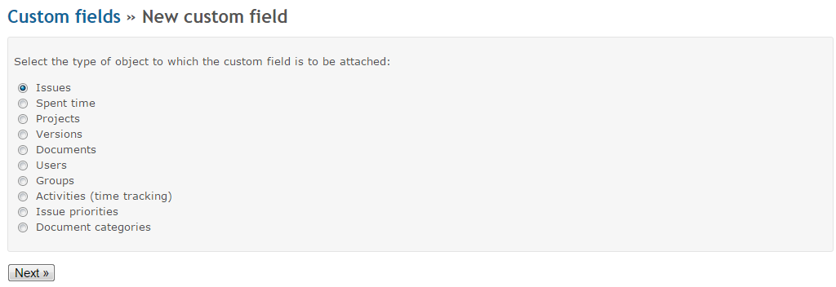
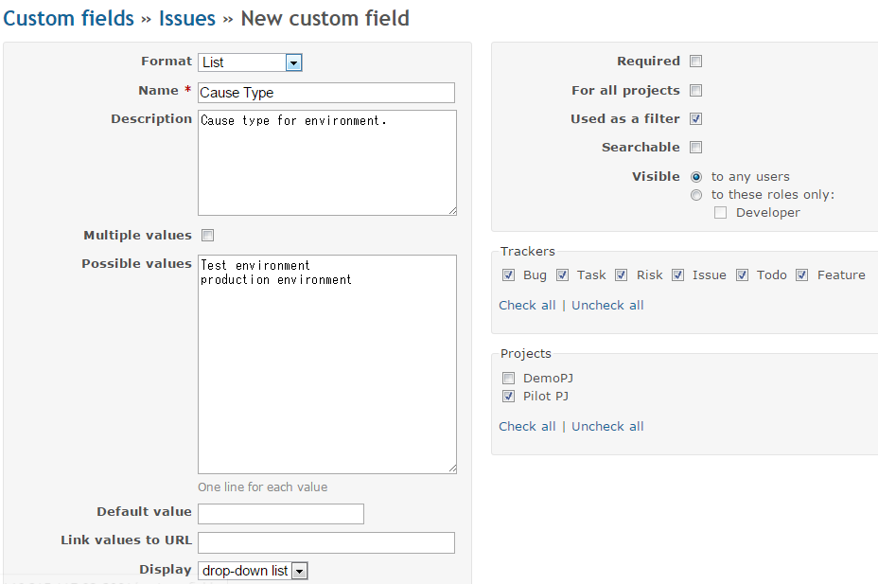
Custom fields
Create new custom field for your project.
You can select the type of object and choose the format input the field name and so on.
If you want to make this field as mandatory you need to check required.
Check Used as a fitter and check tracker what you need and select your projects.

Slide 14
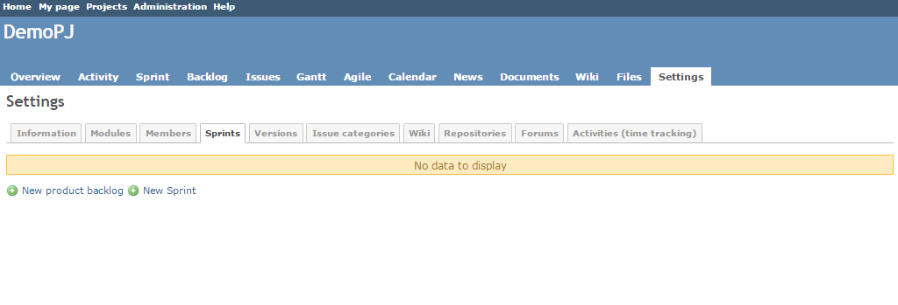
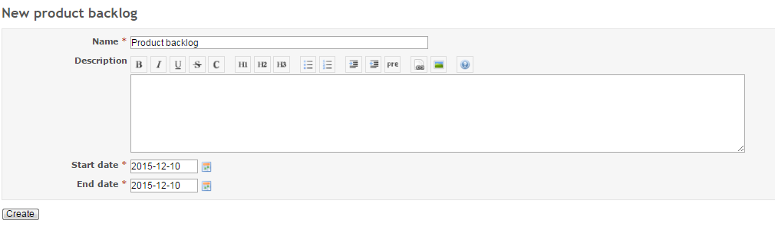
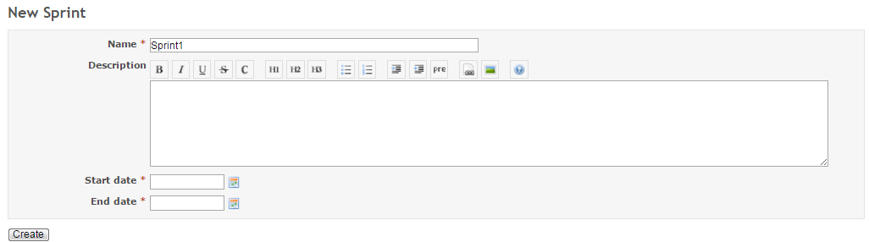
Scrum plug-in settings1/2
Administration->Projects->Your project name->Sprints
Add product back log: Input the backlog name and project period.
Add sprints: Input the sprint name and sprint period.

Slide 15
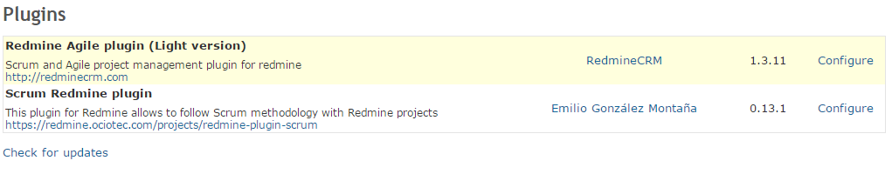
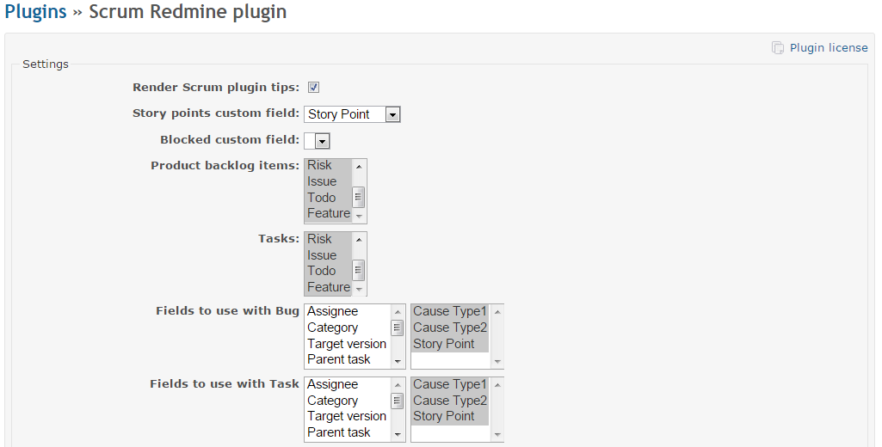
Scrum plug-in setting2/2
Administration->Plugins->Configure
Set the Configure for your scrum plug-in.

Slide 16
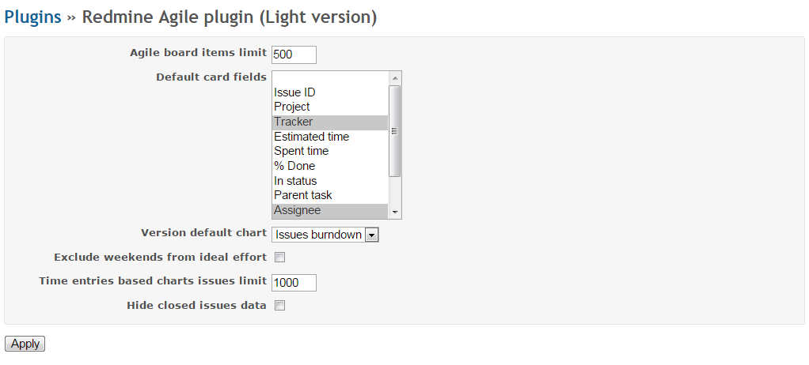
Agile plug-in setting1/2
Administration->Plugins->Configure
Set the Configure for your scrum plug-in.

Slide 17
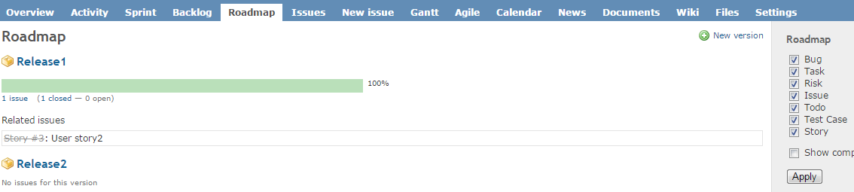
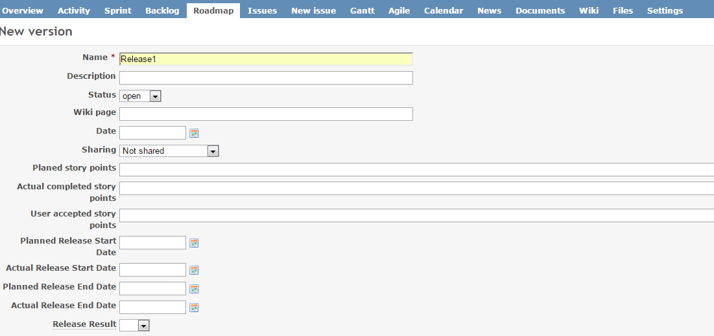
Agile plug-in setting2/2
You can manage the version for each Release on Roadmap menu.
Create the version for each release and see the each release’s roadmap.

Slide 18
Usage
Issues Creation
Back log management
Sprint Management
Release Planning
Agile Board
Log time
Issue View
Issue export
Document Management

Slide 19
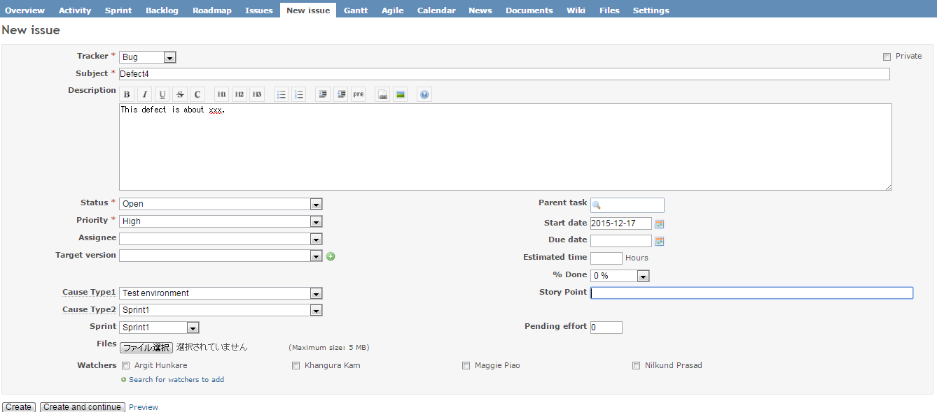
Issues Creation
You can create Issues(User Story/Issue/Bug/Test case etc.) on New Issue menu.
Select the Trackers and input the info what you needed.

Slide 20
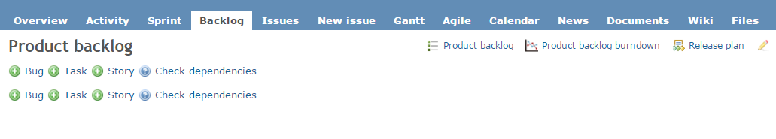
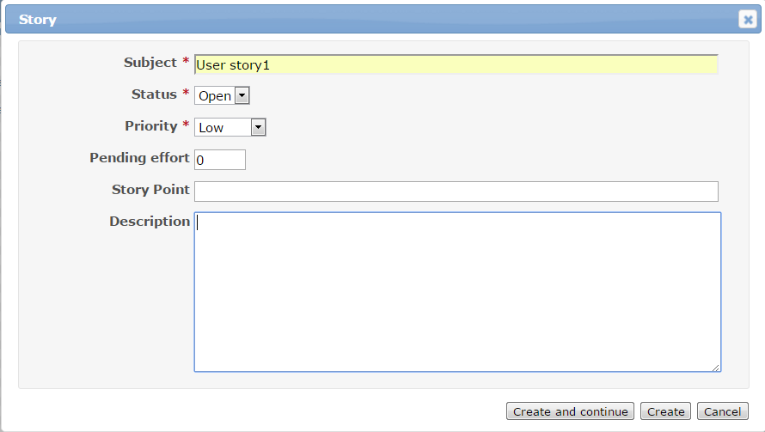
Back log management
You can create product backlog on the Backlog menu.
Create a Story/Task/Bug what you needed.
Input the Subject, status and priority and so on.

Slide 21
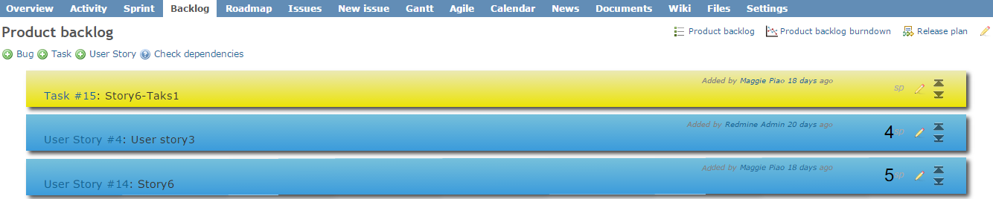
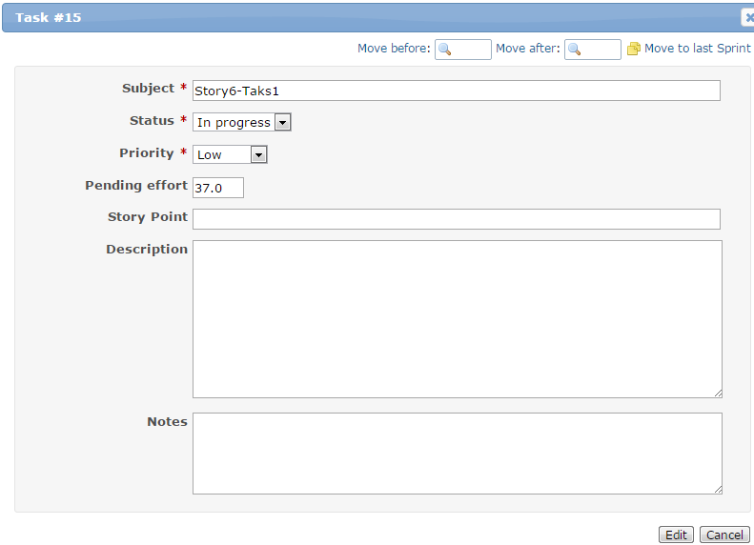
Sprint Management1/4
You can prioritize the backlog and select the backlog for your sprint.
Click the Pencil button and have a update for it. Click the Move to last Sprint link.
You can also update from issue detailed part.Click the subject and edit it to Sprint.
You can add the Story Point and Estimated time info when these are decided.

Slide 22
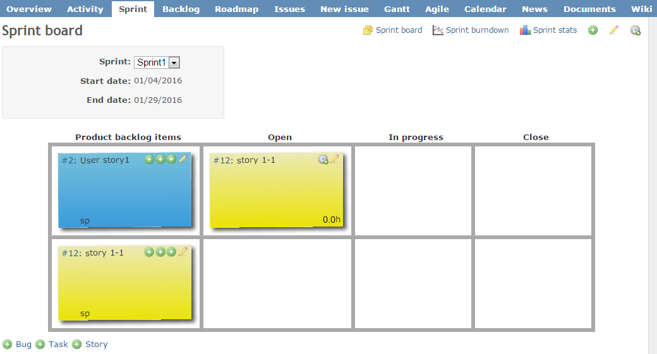
Sprint Management2/4
Add sub task/story for Back log.
And can also add Story/Task/bug at the bottom left.

Slide 23
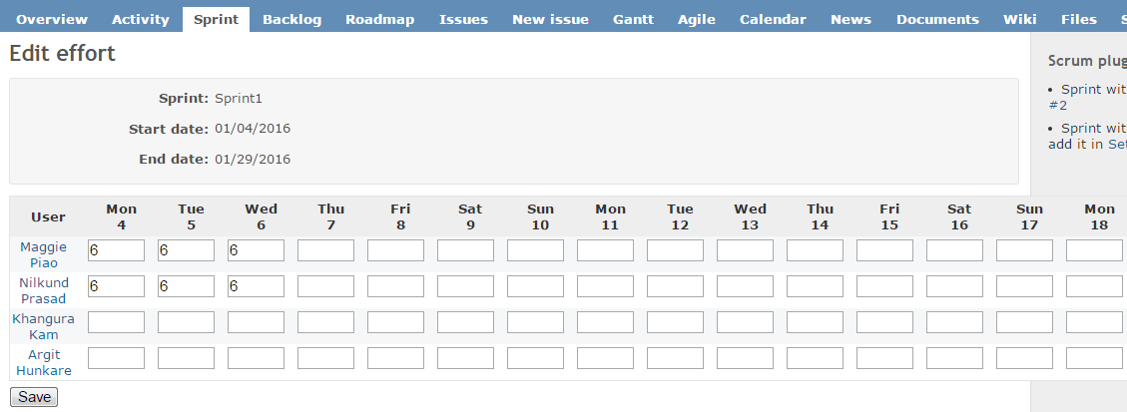
Sprint Management3/4
Add man-effort for each member.

Slide 24
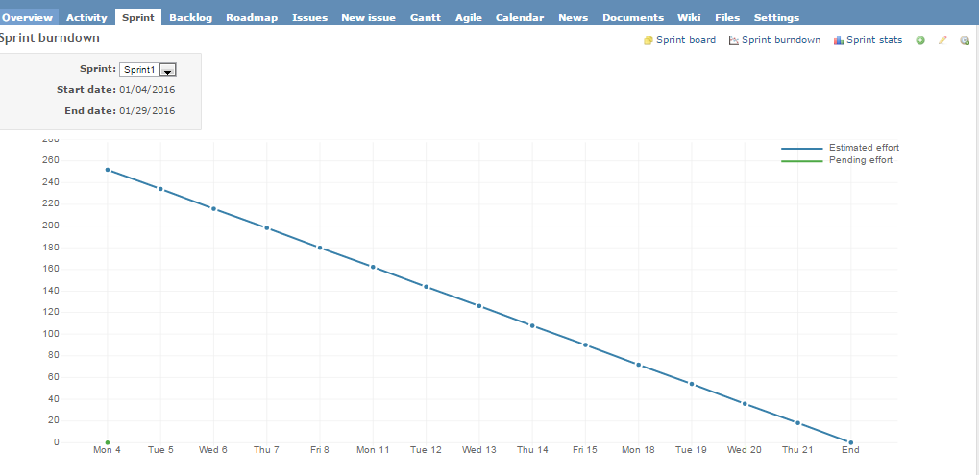
Sprint Management4/4
Can confirm the sprint burndown and sprint state.

Slide 25
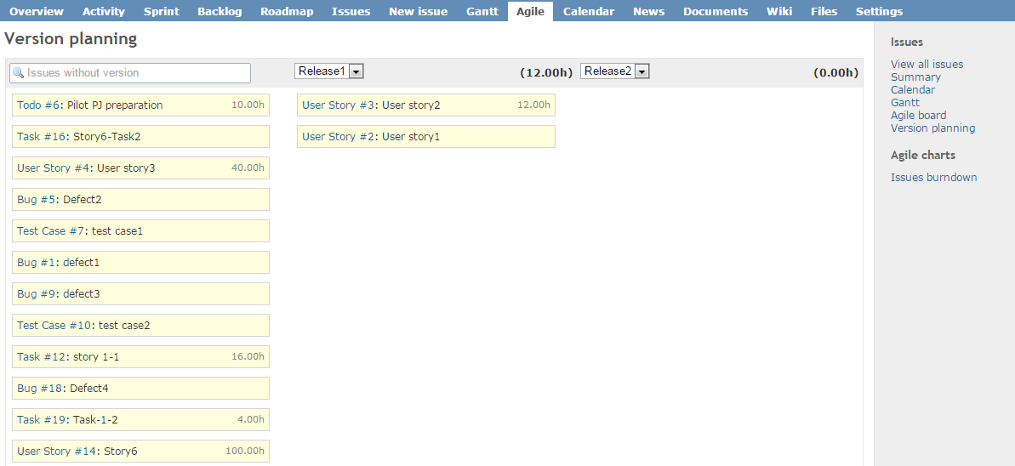
Release Planning
1.You can update the version related information on each issue.
You can also click Agile board->release planning to refer and quick update for it.(Drag the issue)
2.See the Roadmap for each version.

Slide 26
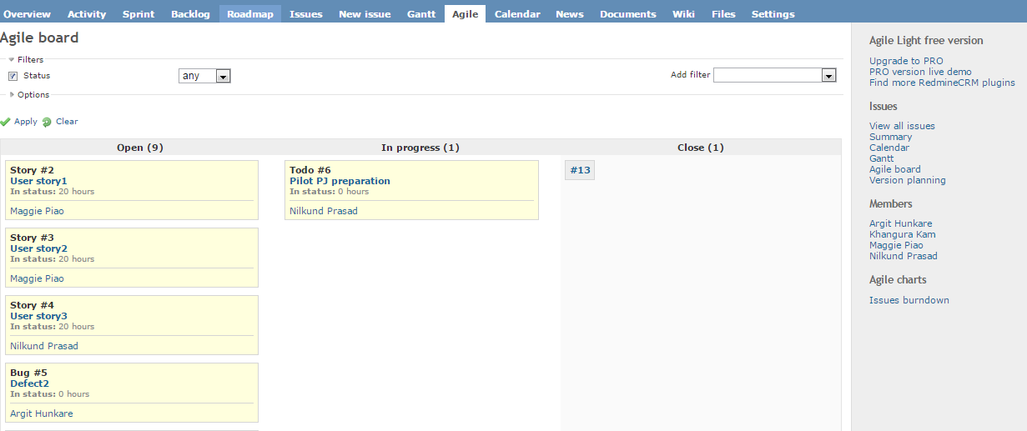
Agile Board
You can confirm your all issues status here.
And can also assign/change some members to the issue and move the issues status.
(Drag the name, Drag the issue etc.)

Slide 27
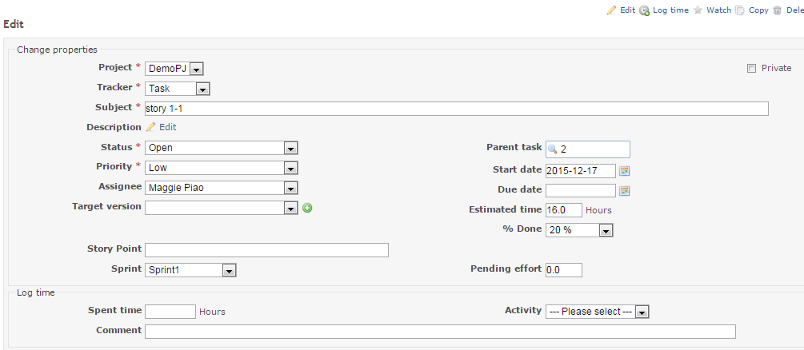
Log time
You can log your time for each task/backlog.
Edit issue and update the status.
(Status, %Done, Spent time, Pending effort, Activity etc.)
You can also log your time on sprint module.

Slide 28
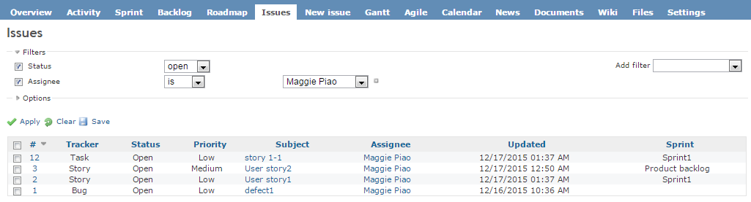
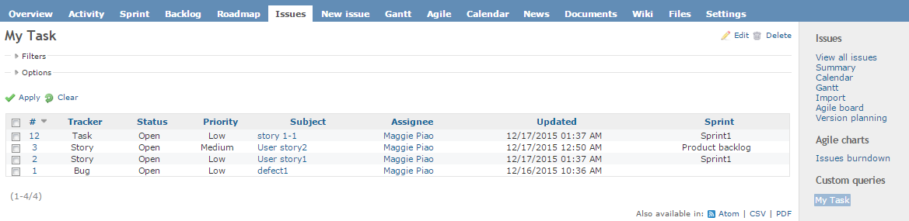
Issue View
You can click Issue menu to confirm all issues(Bug/Task/Todo and so on) status and other info.
You can also add the filter and make the view for you.
Select the condition and click apply and you can also save this view.

Slide 29
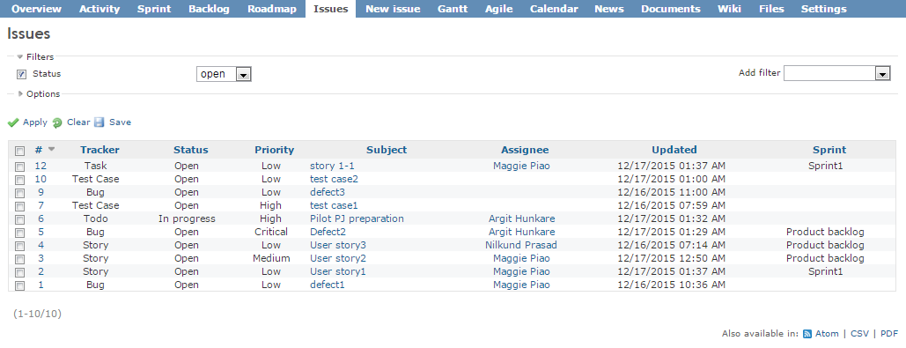
Issue export
You can select some conditions and export the data as CSV and PDF.(Bottom right)
You can also export all issues data.

Slide 30
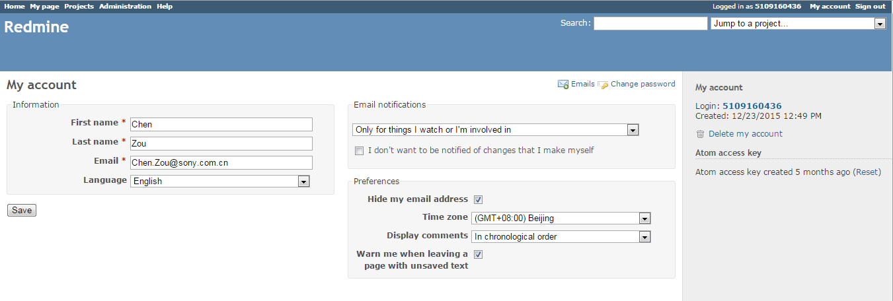
Issue export(Attention)
if Japanese is included in your issues, before you download, you need to use Japanese as your language firstly. Otherwise it will be unreadable codes.

Slide 31
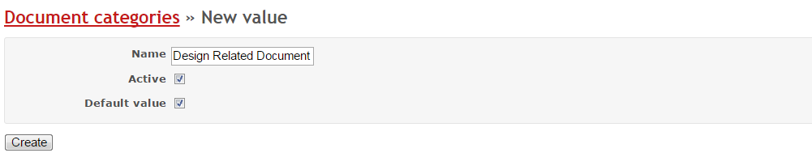
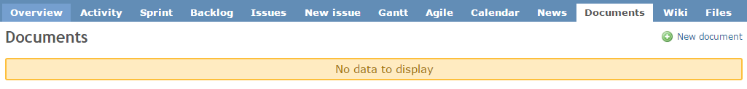
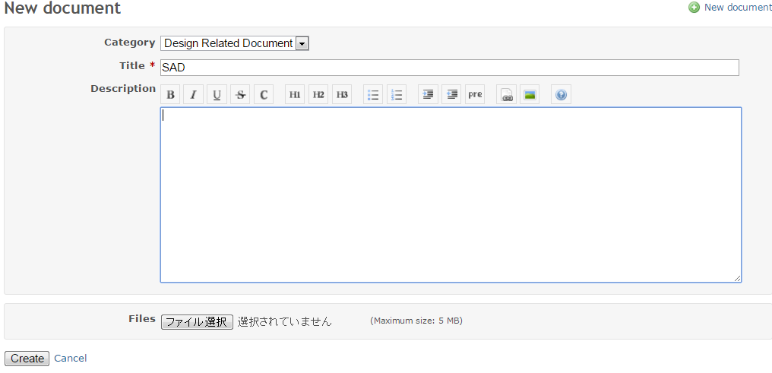
Document Management
You can manage all project related document here.
(design document, test plan etc.)
1.Add the document categories first. Administration->Enumerations->New value
2.Upload the document into tool.
Document->New document->Select Category, input the Title and description and upload Files.

Slide 32
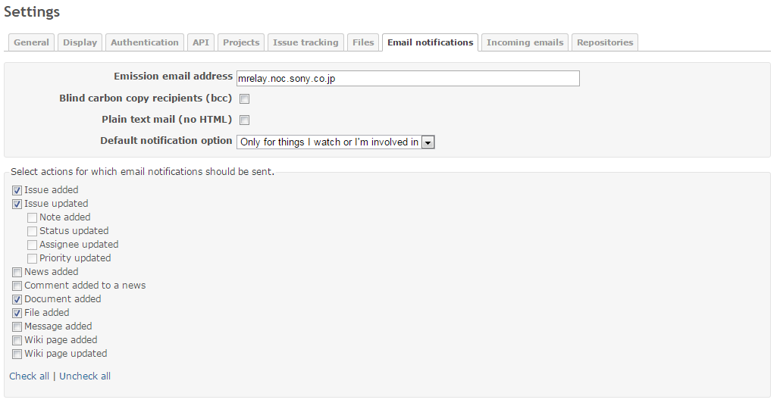
Email Notifications(System default)
Our Redmine environment set basic rules for email.

Slide 33
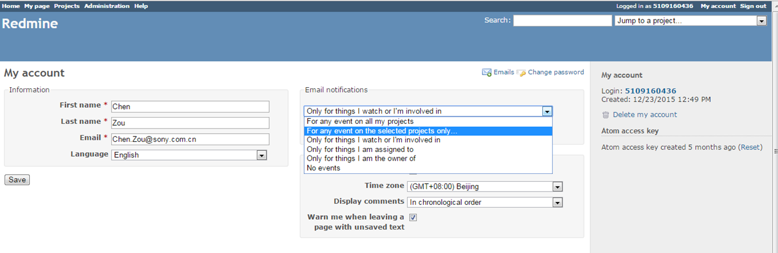
Email Notifications(User setting)
User can set own “Email Notifications” as below.

Slide 34
Application
Application Flow
PJ Setting Introduction

Slide 35
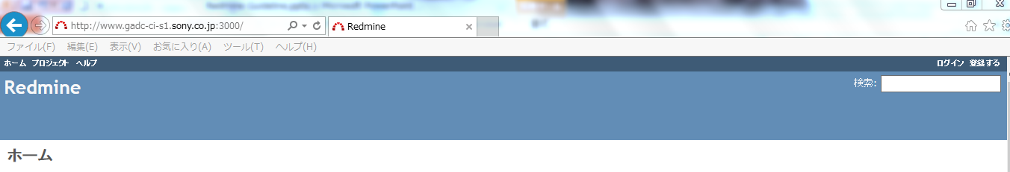
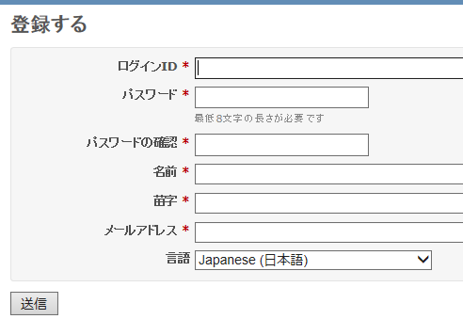
Application Flow
Send the following applying mail to GADC-ITSM-QA-Planning@ap.sony.com
Get response from S&M team of Redmine.
Ask PJ members to register their own user on Redmine.
Link to HP of Redmine and click register button on right-top of HP.
Please use GID as login id.
GID

Slide 36
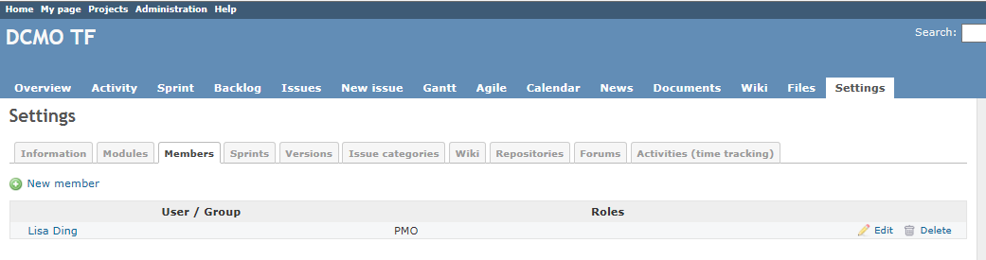
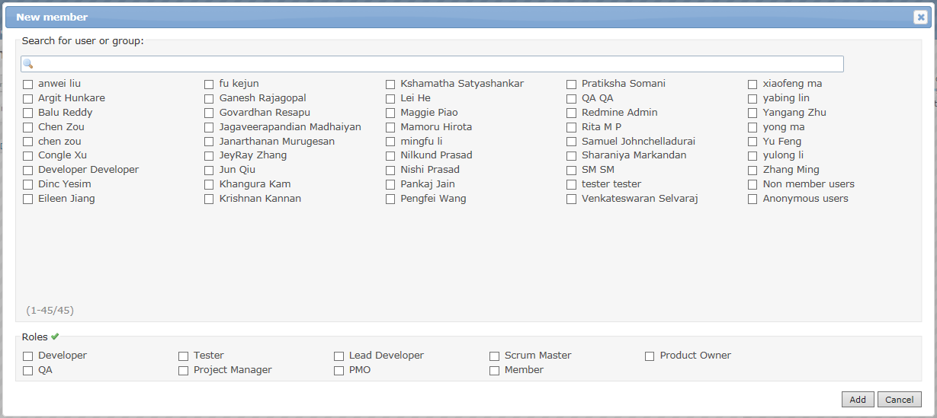
Application Flow
PM/PMO select members and set their roles from setting tag.
Select members
Set members’ role

Slide 37
Application Flow
Members can login to confirm their authority.
Continue to make PJ setting(refer to next sliders) by PMO/PM.

Slide 38
PJ Setting Introduction

Slide 39
Summary
We set some default items for projects utilization in order to reduce setting cost of projects, of course projects also can add other items as their needs. You can refer to the following sliders for introduction of setting.

Slide 40
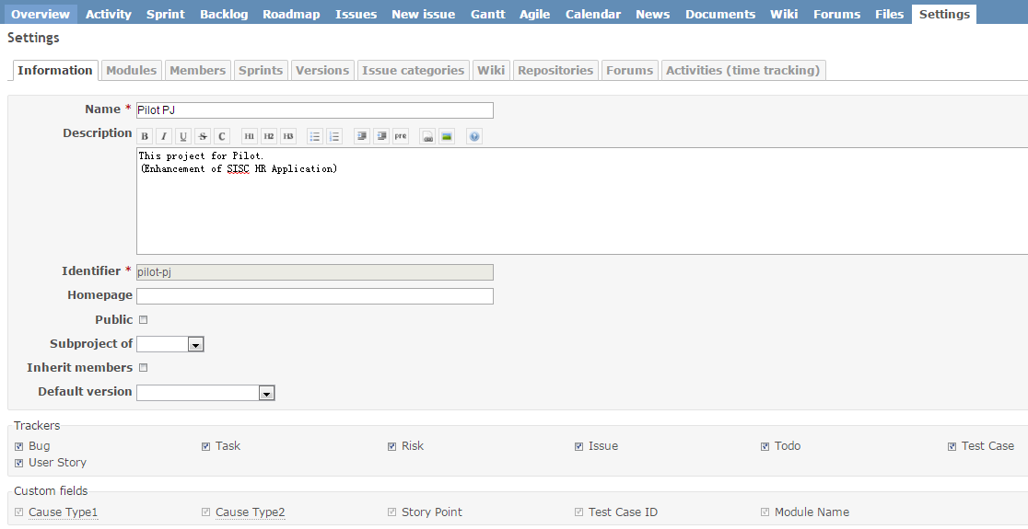
Setting
PO/SM of project can set basic property according to “Settings” tag. But if they want to add some special items, they need to talk with administrator.

Slide 41



Roles & Members
administrator decide roles and users(refer to left image), if you want to add new roles or users, you need to contact administrator.
PO/SM of projects can select members into project and decide their roles.

Slide 42
Information
PO/SM can modify basic information of project
We provide some items about Trackers and Custom fields. If projects want other items, they need to contact administrator.

Slide 43

Information
To custom fields, if project has their own request for utilization position. They need to contact administrator.

Slide 44

Modules
This tag control utilization functions. Project can decide their functions. But we suggest you check all items.

Slide 45

Sprints & Versions
Project can decide sprint and version as their needs.

Slide 46


Issue Categories
Project decide issue categories as their needs.

Slide 47

Wiki & Repositories & Forums
Project decide these items as their needs.

Slide 48

Activities
Project decide active about activities as their needs.
If Project want to add some new activities, they need to contact administrator.

Slide 49
Reference
You can access to the following website to learn more by yourself.
■Redmine website
http://www.redmine.org/projects/redmine/wiki/Guide
■Agile Plug-in
http://redminecrm.com/projects/agile/pages/1
■Scrum Plug-in
https://redmine.ociotec.com/projects/redmine-plugin-scrum/wiki/Wiki

Slide 50
Appendix

